Slide 1
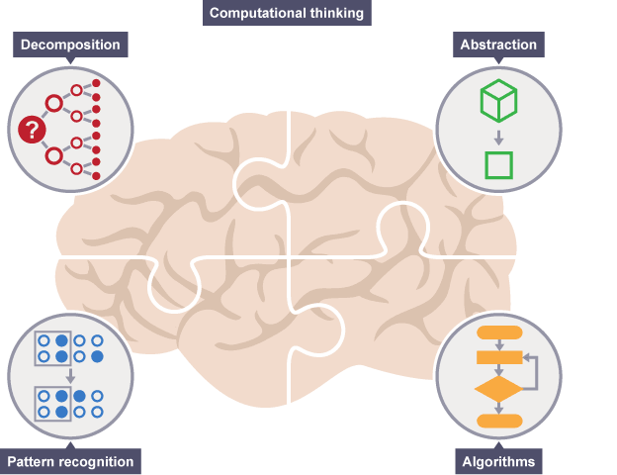
Algorithm
Notes:
Resources:
https://www.bbc.com/education/guides/zp92mp3/revision/1
https://computationalthinkingcourse.withgoogle.com/unit

Slide 2



Learning Outcomes
Understand building blocks of Algorithm
Define Sequence, Loops, Conditionals & Functions
Learn 15 mins
Activity 60 mins
Tea break

Slide 3
Algorithm
A computer does 2 things
Performs instructions
Remembers their results
We need to give the computer unambiguous instructions such that when followed step by step the execution will finish and yield a result.

Slide 4
Basic coding with block programming
studio.code.org/s/frozen/lessons/1/levels/1
Once we have understood the fundamental of algorithm through this exercise, we can then apply it in the programming with HTML, JavaScript and RPA in the later part of the lessons
Notes:
studio.code.org/s/frozen/lessons/1/levels/1

Slide 5

Building Blocks of Code
Sequence
Loops
Conditional Statements (IF)
Functions

Slide 6
Sequence
Sequencing is the specific order in which instructions are performed in an algorithm

Slide 7
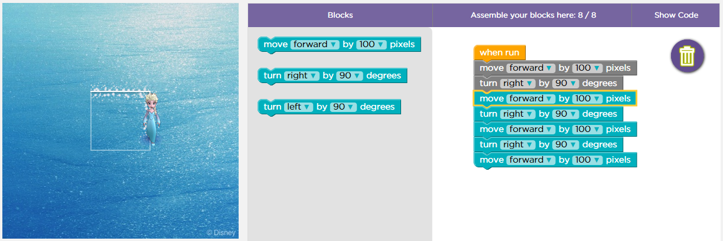
Sequence
Code with Anna and Elsa #3 - Code.org
Sequencing is the specific order in which instructions are performed in an algorithm
Notes:
Code with Anna and Elsa #3 - Code.org

Slide 8
Loops
A loop is a sequence of instruction(s) that is continually repeated until a certain condition is reached

Slide 9

Introduction to Loops
https://www.youtube.com/watch?v=d7e48cYq7uc

Slide 10
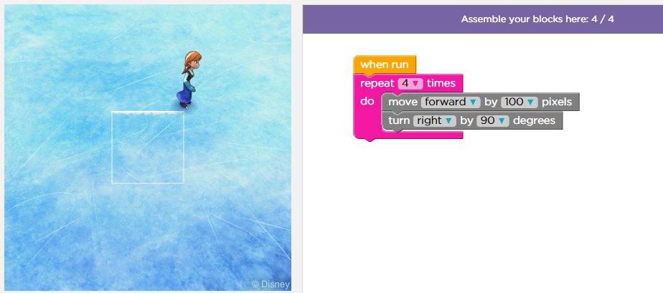
Loops
Code with Anna and Elsa #4 - Code.org
A loop is a sequence of instruction s that is continually repeated until a certain condition is reached. In this case, it is 4 times
Notes:
Code with Anna and Elsa #4 - Code.org

Slide 11
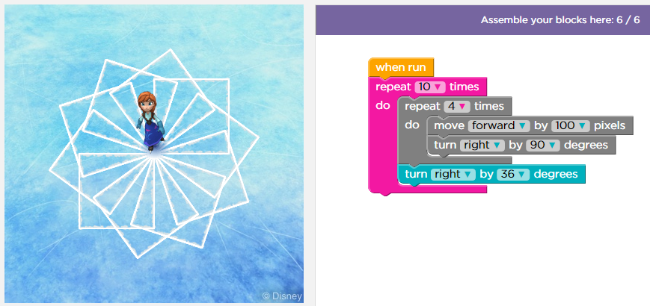
Loops (counter controlled)
Code with Anna and Elsa #6 - Code.org
A loop is a sequence of instruction s that is continually repeated until a certain condition is reached
Notes:
Code with Anna and Elsa #6 - Code.org

Slide 12
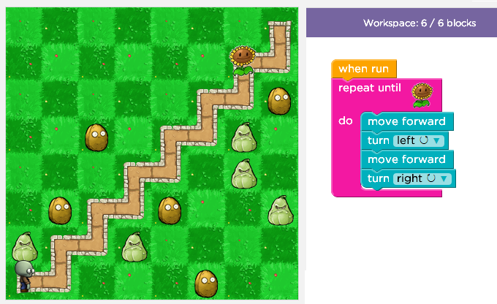
Loops with conditions (Until)
Classic Maze #12 - Code.org
A loop is a sequence of instruction s that is continually repeated until a certain condition is reached
In some programming languages it will look like:
For (var i= 0; i<4; i++)
{
Move();
TurnLeft();
Move();
TurnRight();
}
//repeat until i become 4
Notes:
Classic Maze #12 - Code.org

Slide 13
Conditional
A condition statement helps programs make decisions by asking them to check if a condition is met before performing an action

Slide 14

(Zombie) Hour of Code Introduction to If
https://www.youtube.com/watch?v=m2Ux2PnJe6E

Slide 15
(Ice Age) Hour of Code Introduction to If-else
https://www.youtube.com/watch?v=QM8fAy47kHc

Slide 16
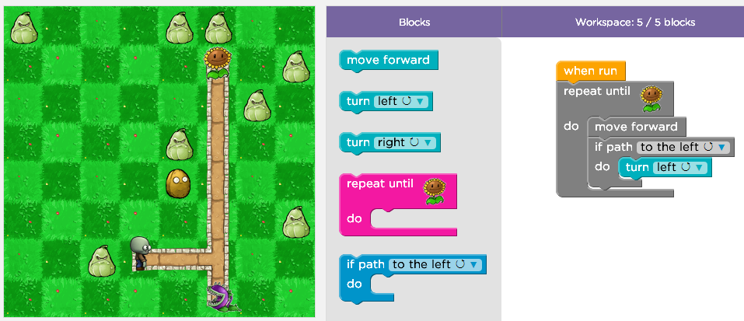
Condition Statements (IF)
Classic Maze #14 - Code.org
A condition statement helps programs make decisions by asking them to check if a condition is met before performing an action
Notes:
Classic Maze #14 - Code.org

Slide 17
Functions
A function is a group of instruction for a particular purpose

Slide 18
(Frozen) Hour of Code Introduction to Functions
https://www.youtube.com/watch?v=0eo0ESEX9DE

Slide 19
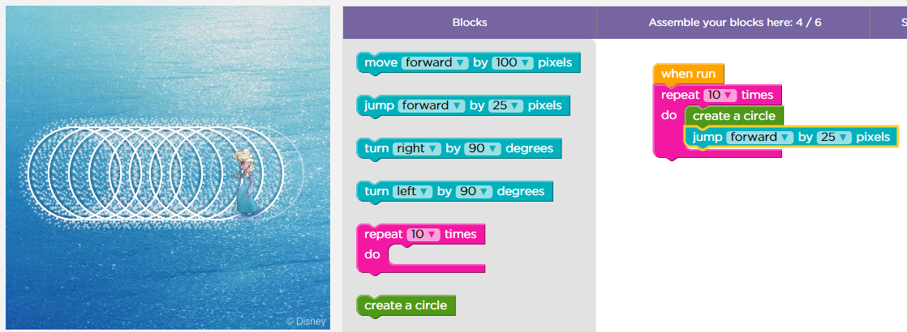
Functions
https://studio.code.org/s/frozen/lessons/1/levels/14
A function is a group of instruction for a particular purpose and create a circle in this case is the function we use

Slide 20
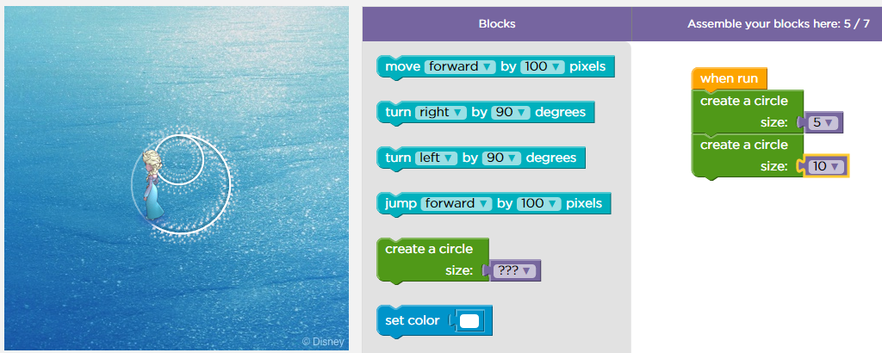
Parameterised Functions
https://studio.code.org/s/frozen/lessons/1/levels/16
A function can sometimes take in some parameters/ inputs so that the result/ output can be different

Slide 21


Activity
Individual
Hour of Code

Slide 22

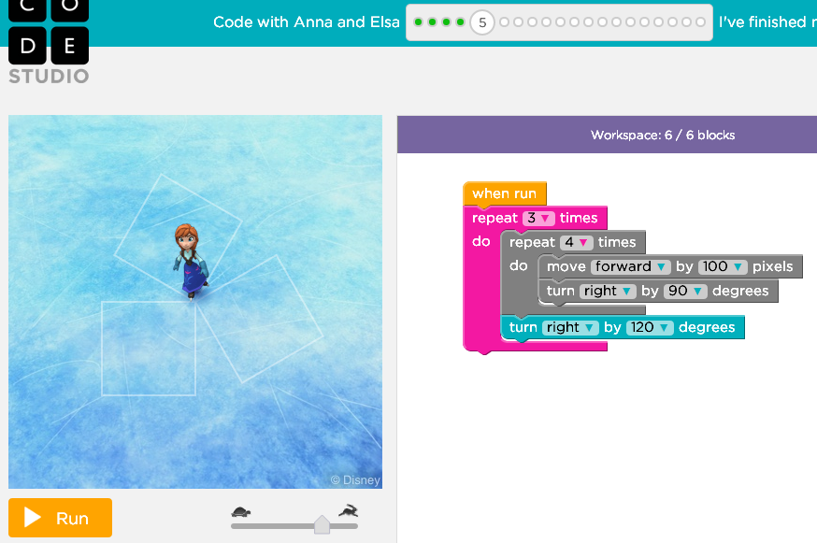
Hour of Code – exercise 1
Code with Anna and Elsa #5 - Code.org

Slide 23
Hour of Code – exercise 1 soln

Slide 24
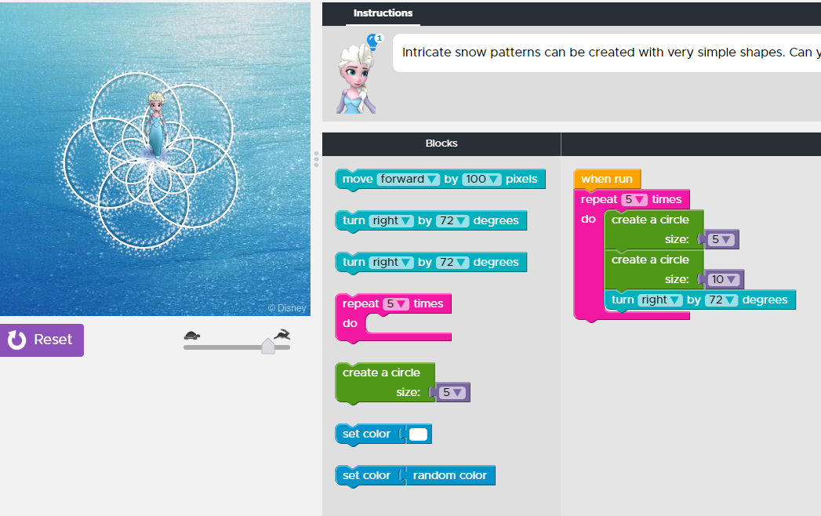
Hour of Code – exercise 2
Code with Anna and Elsa #17 - Code.org

Slide 25
Hour of Code – exercise 2 soln

Slide 26
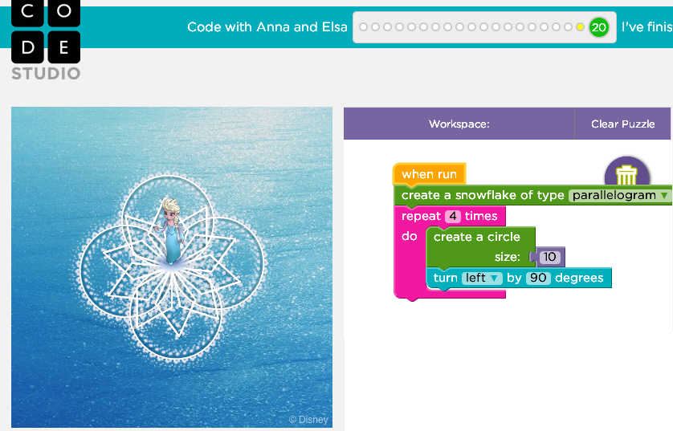
Hour of Code exercise 3
Code with Anna and Elsa #20 - Code.org

Slide 27
Hour of Code exercise 3 soln

Slide 28

Thank you

Slide 29
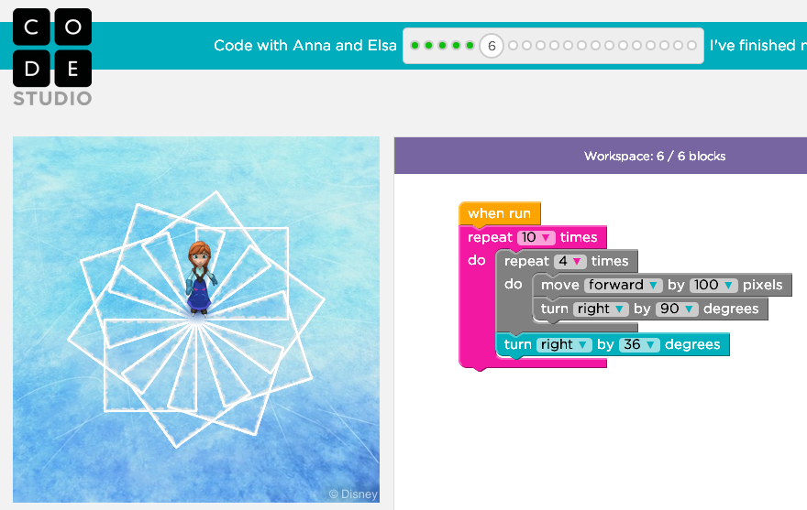
Hour of Code

Slide 30
Hour of Code (Solution Part 1)

Slide 31
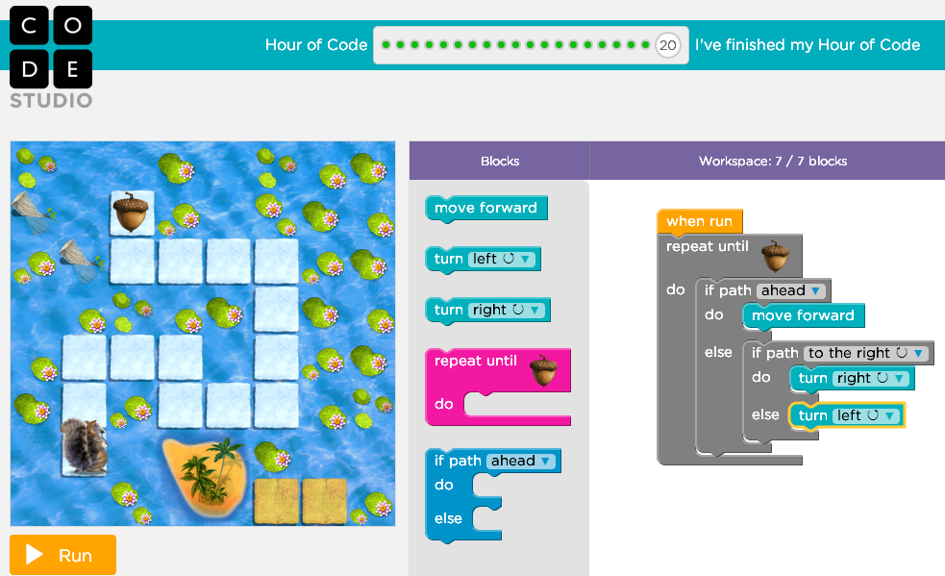
Hour of Code (Solution Part 2)

Slide 32
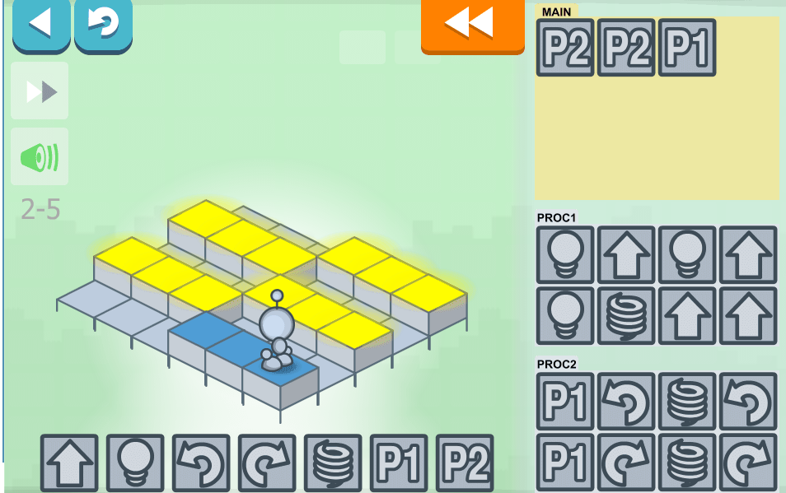
Hour of Code

Slide 33
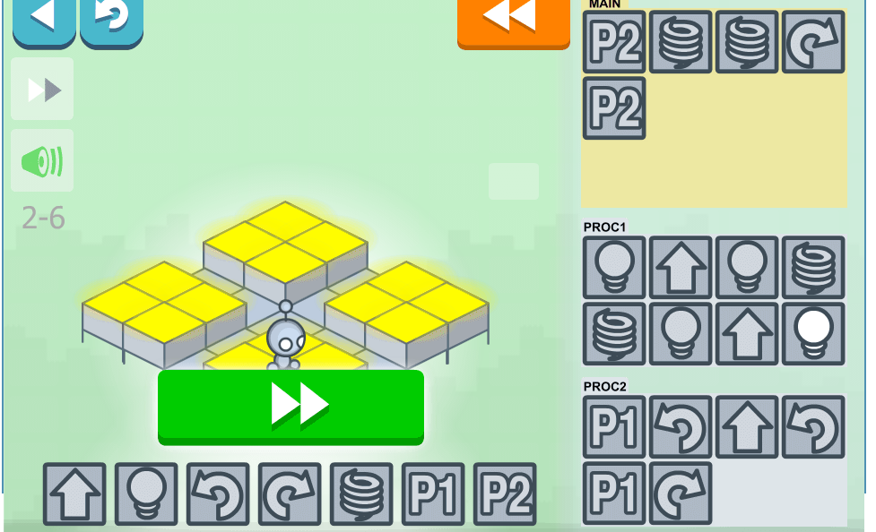
Hour of Code

Slide 34
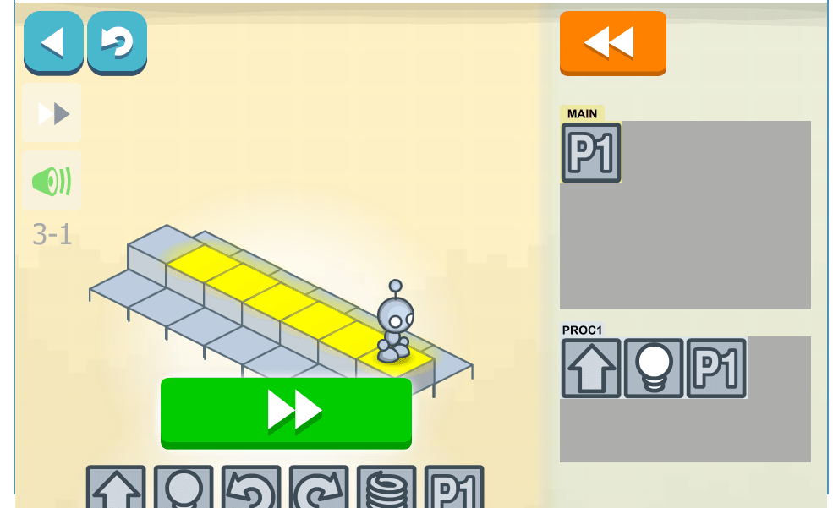
Hour of Code

Slide 35
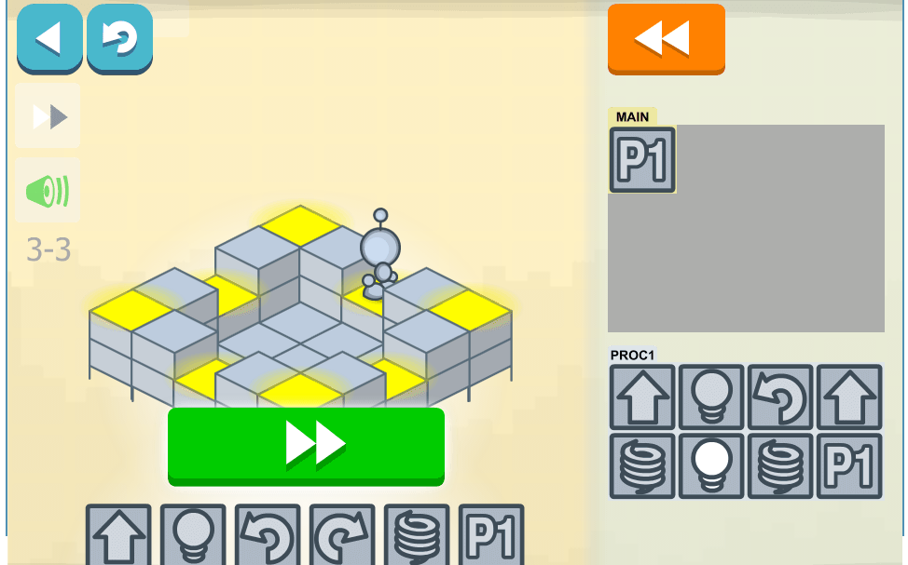
Hour of Code

Slide 36
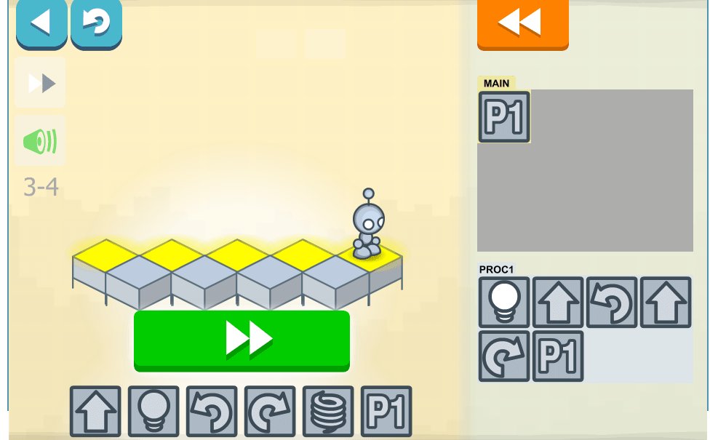
Hour of Code

Slide 37
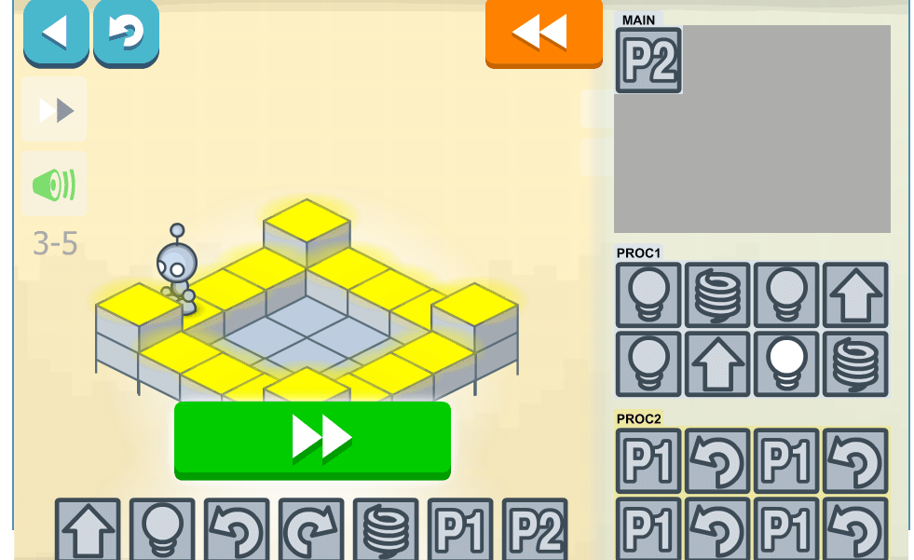
Hour of Code (Solution Part 3)

Slide 38
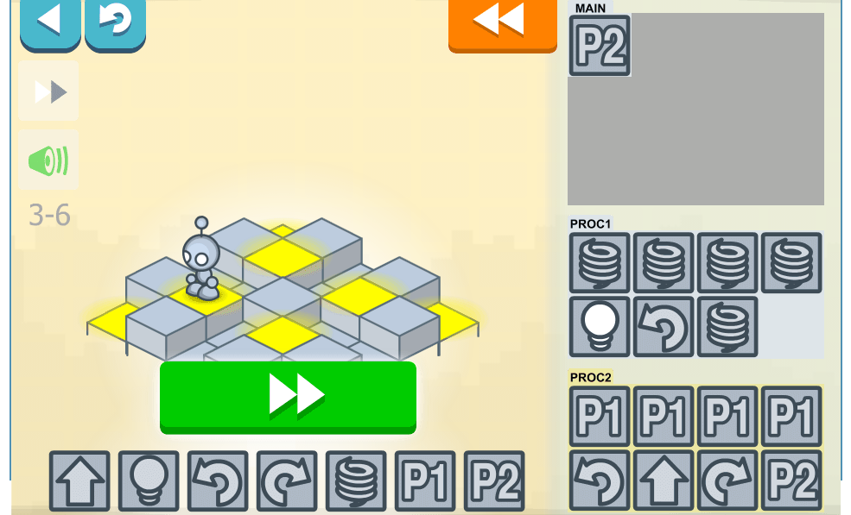
Hour of Code

Slide 39
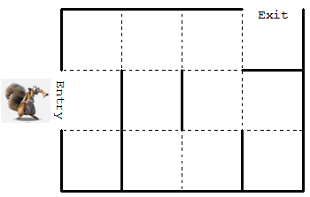
Challenge Practice on Algorithm
With the given commands, use only 6 commands to get the squirrel to enter and exit the maze
Commands
turn
left
turn
right
more forward
Repeat until
Outside the maze
Repeat until
Path ahead

Slide 40
Challenge Practice on Algorithm
1:
2:
3:
4:
5:
6:

Slide 41
Challenge Practice on Algorithm (Solution)
1:
2:
3:
4:
5:
6:
more forward
Repeat until
Outside the maze
turn
left
Repeat until
Path ahead
turn
right
more forward

